Slide 1
Forecasting Fine-Grained Pollutant Levels
Nilesh Patil & Jiang Shang

Slide 2
Background
Inspiration
When Urban Air Quality Meets Big Data by Dr. Yu Zheng
What is fine grained pollutants?
< 2.5μm
Problem Statement
Building a predictive model for PM2.5 levels in the next 24 hours for distributed locations
Why do we want to forecast PM2.5?
Dangerous
Stays longer in air
Potential Significance
Health alerts
Supplementing pollution control measures
Notes:
Dr. Yu Zheng initiates the study of inferring real-time and fine-grained air quality throughout a city using BigData. The cities he’s done this study include Beijing, Shanghai, Shenzhen, and Wuhan.
Fine grained pollutants refers to the particles in atmosphere having size smaller than 2.5 micrometer. They are referred as PM2.5 by United States EPA(Environmental Protection Agency)
Building a predictive model for PM2.5 levels across USA
In every pollutant monitoring study, fine grained particulate measurements are mentioned alongside the gaseous pollutants. They are especially dangerous with a 36% increase in lung cancer per 10 microgram per cubic meter beyond current safety standards. Since they are so small and light, they stay longer in air and this increase the chances of human and animals inhaling.
Most cities issue health alerts in USA and the better a forecast is, the more effective it is. A reliable forecasts provides the local authorities an opportunity to issue area specific measures for controlling particulate levels.

Slide 3
Methodology Overview
Data source
EPA(United States Environmental Protection Agency)
https://aqsdr1.epa.gov/aqsweb/aqstmp/airdata/download_files.html
Parameters used
PM2.5, Wind, Temp, Pressure, Relative Humidity and dewpoints, Ozone, SO₂, CO, NO₂
General modeling approach:
We test out how the wind speed/temperature/pressure/humidity…etc in the last 12 hours ago/48 hours/1 week/ month/ year affect a given locale’s PM2.5 level
We also include PM2.5 as our input for the same time windows
Algorithms of choice
Random Forests
KNN
Validation
70:30 training test set

Slide 4
Methodology Detail

Slide 5
Finding

Slide 6
Finding cont’

Slide 7
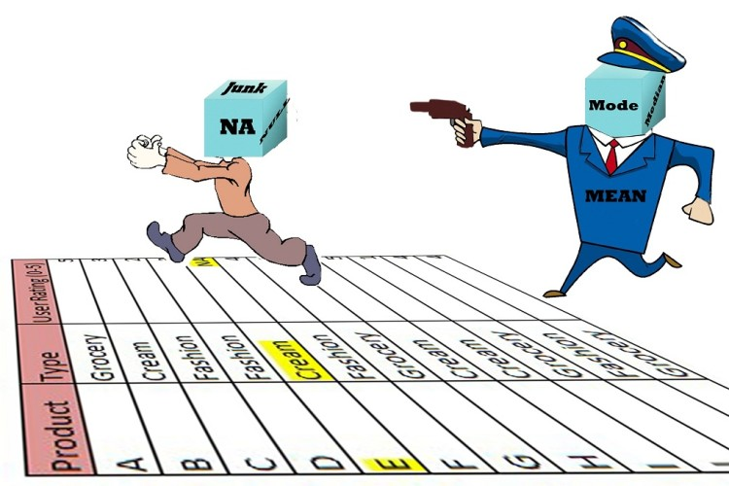
Challenges
Effective discrimination
Identify the most effective parameters which will render better predictions than the rest from our large data source
Lots of NaNs
Although we have many parameters ranging from 500+ cities, there are only a few cities that have complete data points for all the parameters.
Ambiguous parameter readings
At the same data, location, there exist parameter reportings that are drastically different.

Slide 8
Reference
Yu Zheng, Furui Liu, and Hsun-Ping Hsieh. 2013. U-Air. Proceedings of the 19th ACM SIGKDD international conference on Knowledge discovery and data mining - KDD '13 (August 2013). DOI:http://dx.doi.org/10.1145/2487575.2488188
Anon. Air pollution and lung cancer incidence in 17 European cohorts: prospective analyses from the European Study of Cohorts for Air Pollution Effects (ESCAPE). Retrieved July 10, 2013 from https://www.ncbi.nlm.nih.gov/pubmed/23849838
https://aqsdr1.epa.gov/aqsweb/aqstmp/airdata/download_files.html
http://scikit-learn.org/stable/supervised_learning.html#supervised-learning

